Slide 1




Mirai
Your gateway to the future

Slide 2



Problem
Security breaches remain a major concern in high-traffic facilities.
Traditional access systems (cards, PINs) are easily shared, lost or misused.
Entry points create long queues and congestion during peak hours.

Slide 3



Solution
A smart AI-powered gateway where users

Slide 4




Product demo
Approach the Gate
Face scanned
Done under 30 seconds

Slide 5

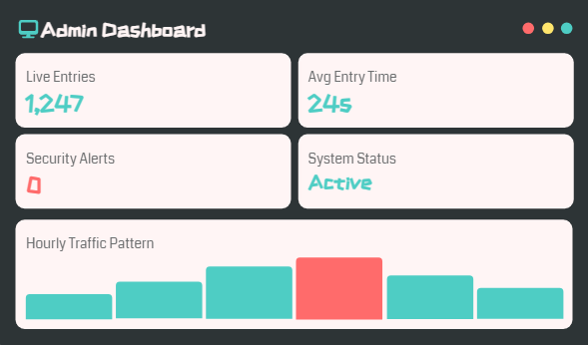
Product demo

Slide 6


Competition
IDEMIA
NEC Corporation
Thales Group
Lower cost
Easy to integrate
Available everywhere

Slide 7

Bussiness model

Slide 8

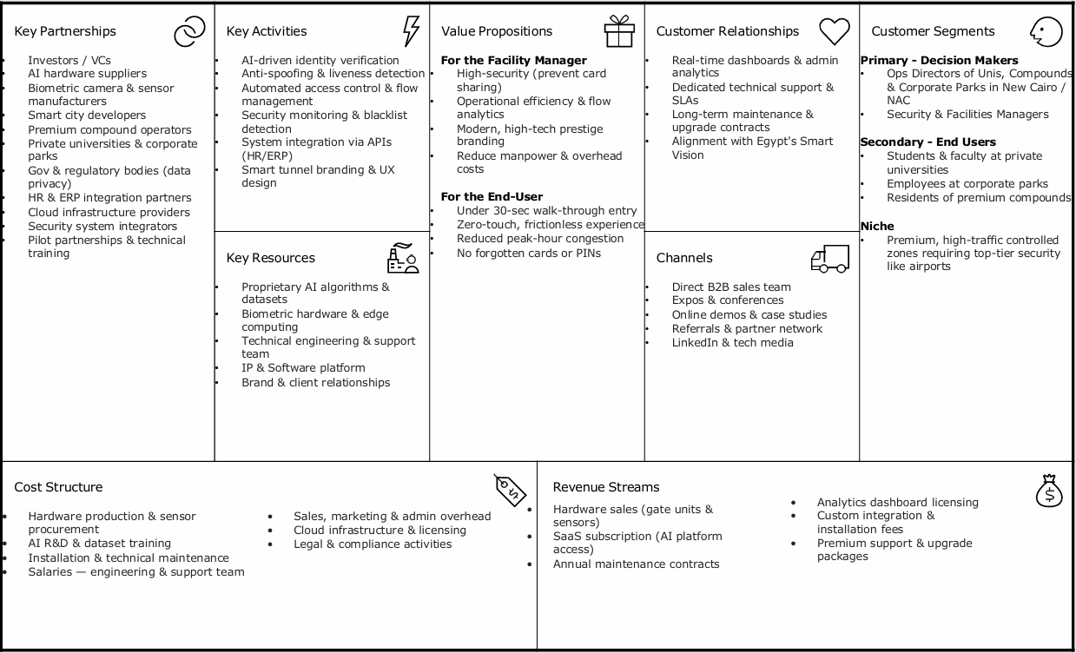

Slide 9



Bussiness model
$120M+
Projected Market Capture
$1,200 – $5,000
Average Monthly Revenue / Client
$15M+
Projected Revenue (5 Years)

Slide 10
Our team
Khadija Ahmed - 252600430
Joumana Mostafa - 252600728
Sandy Amr - 252601389
Kirollos George - 252600431

